Slide 1
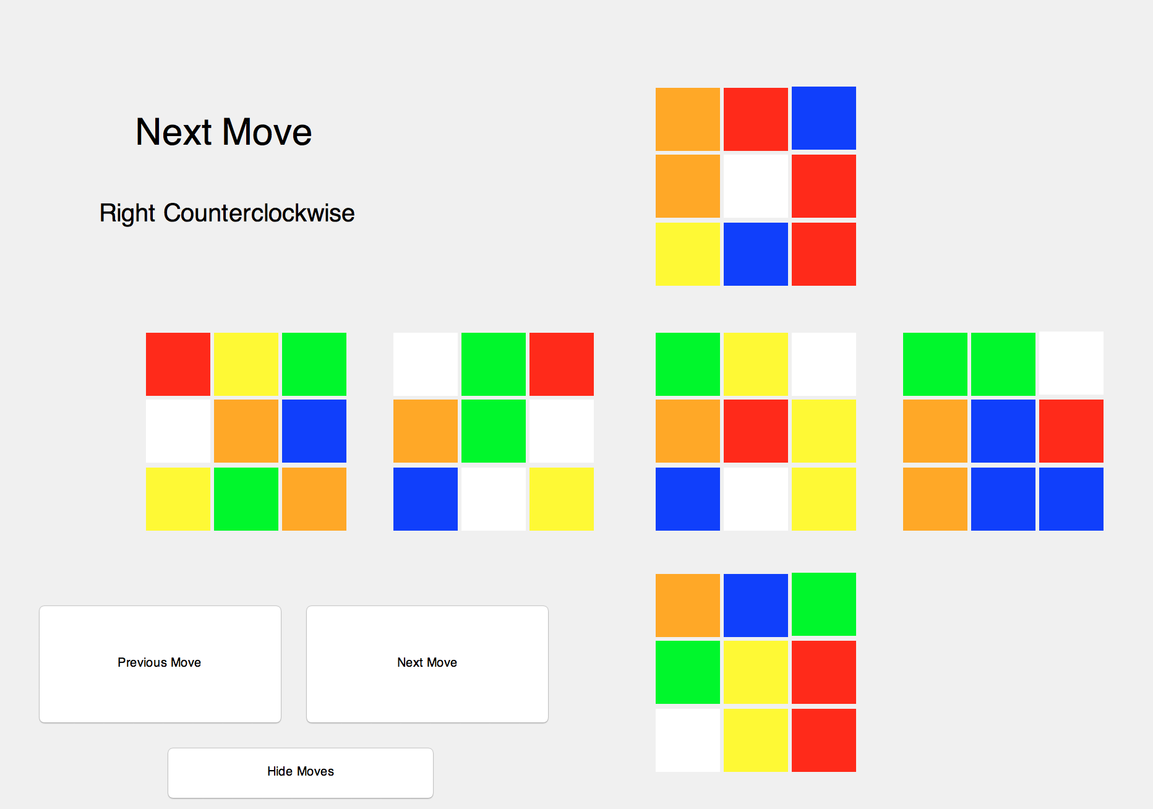
Demo #1

Slide 2
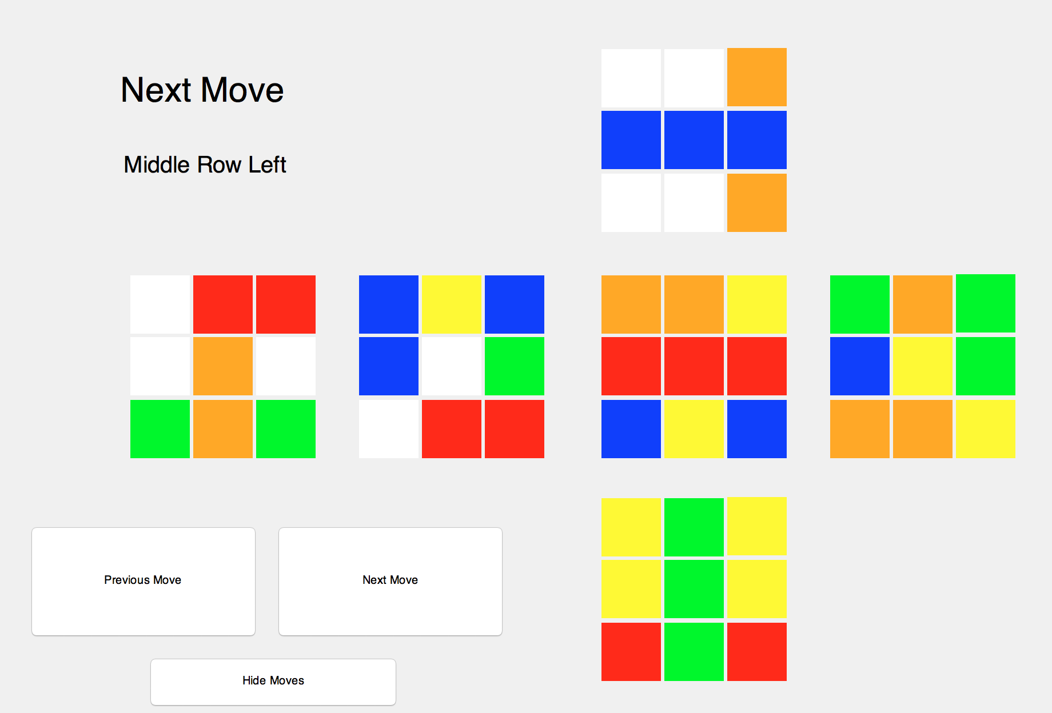
Demo #2

Slide 3
Algorithm
Solves by stages
Total of 5 stages
Solves in a specific order
Bottom Face, Bottom Row, Middle Row, Top Face, Top Row
Optimization of moves at end
Different end goals
Written in Python. Converted to MATLAB for the GUI demonstration but official algorithm is in Python. MATLAB is for demo only

Slide 4
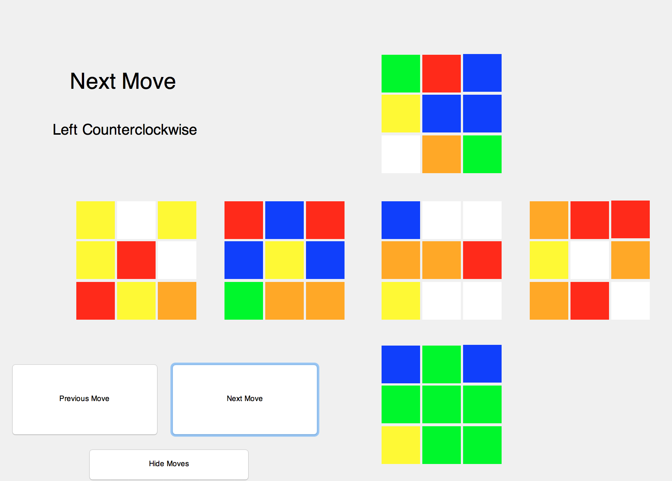
Stage 1
Split up into two steps
Get a cross on the bottom of the face
Correct orientation of cubes

Slide 5
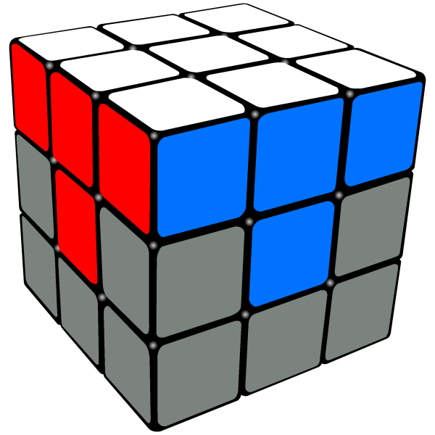
Stage 2

Slide 6
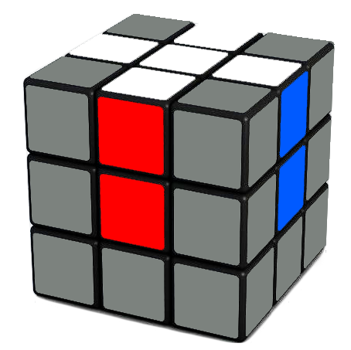
Input Cube
Output Cube

Slide 7
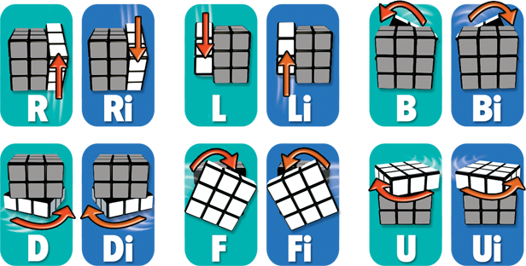
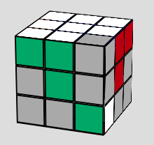
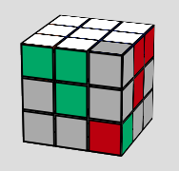
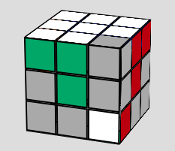
If the Color piece is on the Top Face
Rotate the cube till the color piece is under the desired place.
After Rotation, we will have one of these cubes

Slide 8
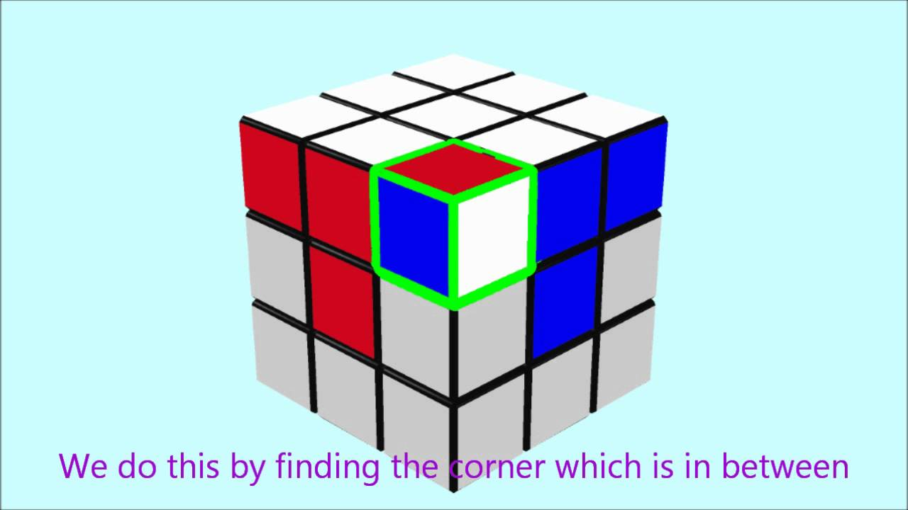
If the Color piece is on the Bottom Face
Bring the piece on the top face first, then swap

Slide 9
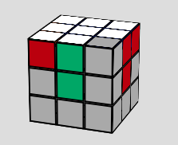
If the Color piece is wrongly placed
Bring the wrongly placed piece to the top row and then solve

Slide 10
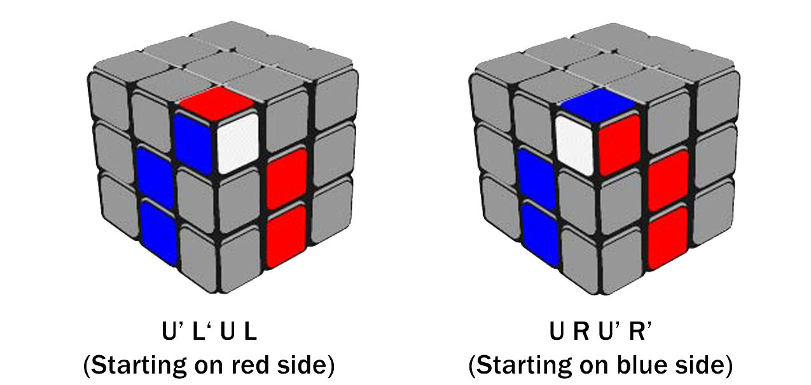
The Dilemma with the Moves

Slide 11
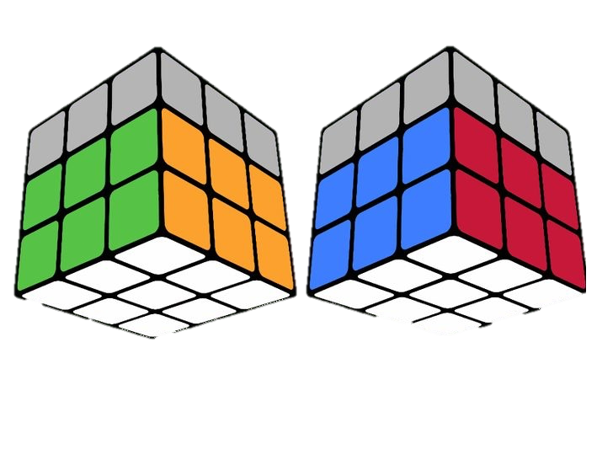
Stage 3
Goal of the function was to solve the middle layer of the Rubik’s Cube

Slide 12
Major Steps in solving the Cube
Right Algorithm
Left Algorithm

Slide 13
Tricky Cases!

Slide 14
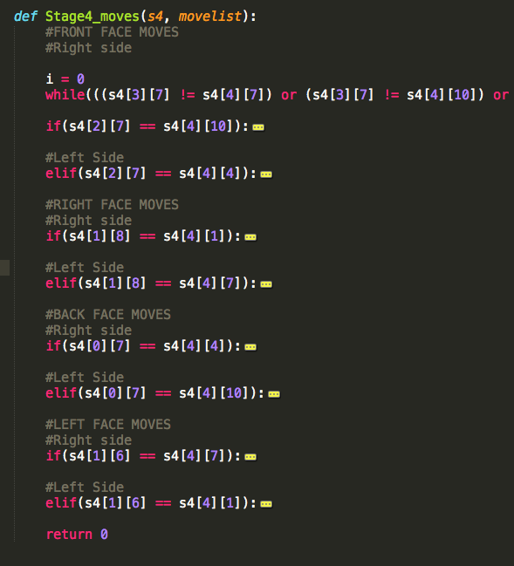
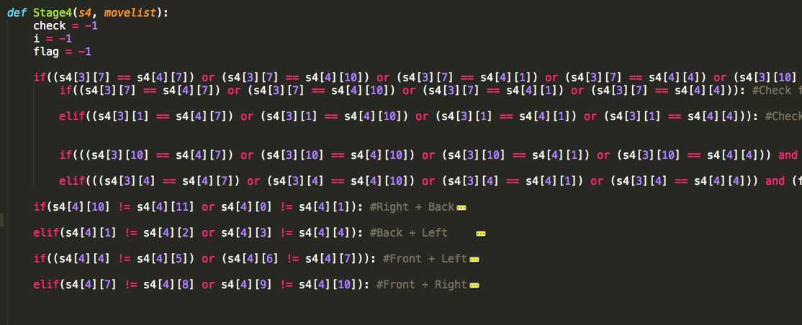
The Implementation

Slide 15
Rubik’s Cube Stage 4
The Top Layer

Slide 16
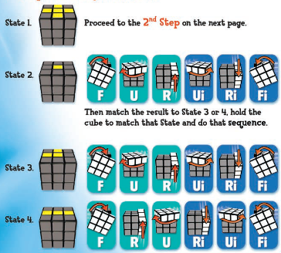
Step 1: The cross
Match the pattern on the top face to specific sequence

Slide 17
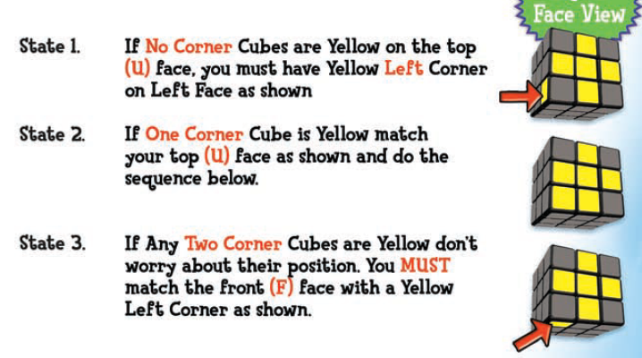
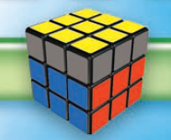
Step 2: Solving the Full Top Face
Completed Stage 4
Match the top face to the following state and then do the sequence R -> U -> Ri -> U -> R -> U -> U -> Ri
If the top face is still not complete then repeat the instruction above until the entire top face is complete.

Slide 18
Rubik’s Cube Stage 5
Wrapping it Up.

Slide 19
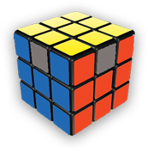
Step 1: Position Yellow Corners Correctly

Slide 20
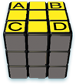
Getting the Right Corners
Sequence: Ri -> F -> Ri -> B -> B -> R -> Fi -> Ri -> B -> B -> R -> R -> Ui
We define the right corners by turning the top face of the cube clockwise until at least two corner pieces of the cube are in the correct position
Once that is done, we perform a sequence of moves based on the location of the right corners until all four of them are correctly placed.
This process is done iteratively.

Slide 21
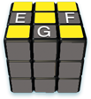
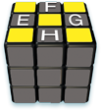
Step 2: Position Yellow Edges Correctly

Slide 22
Solving the cube by correcting the edges
Sequence CW : F -> F -> U -> L -> Ri -> F -> F -> Li -> R -> U -> F -> F
Sequence CCW: F -> F -> Ui -> L -> Ri -> F -> F -> Li -> R -> Ui -> F -> F
There are two different outcomes after Step 1 and two different sequences that needs to be performed based on the location of the edges.
If one edge is in the correct location, we orient the cube so that the solved edge is in the back end of the cube and decide which direction the incorrect edges need to move and perform one of the 2 sequences.
If all four edges are incorrect, we do any one of the two sequences and then perform the sequence based on the conditions with one correct edge

Slide 23
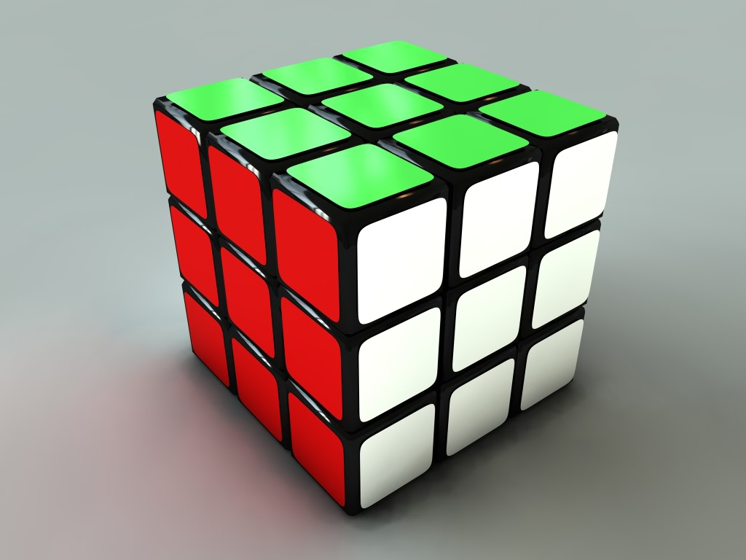
Congratulations! You have solved the Rubik’s Cube

Slide 24
Stage 6
Goal 1: Optimization
Reduce the number of steps
Reduce physical time
Goal 2: Create different designs
Multicolored Cross
Square in the Middle

Slide 25
Optimization
Eliminate redundant moves
Each move has a complement
“B” <-> “Bi”
“R” <-> “Ri”
Etc..
[ R, R, L, L, B, B, B, D, F, D …] <-> [ R, R, L, L, Bi, D, F, D …]

Slide 26
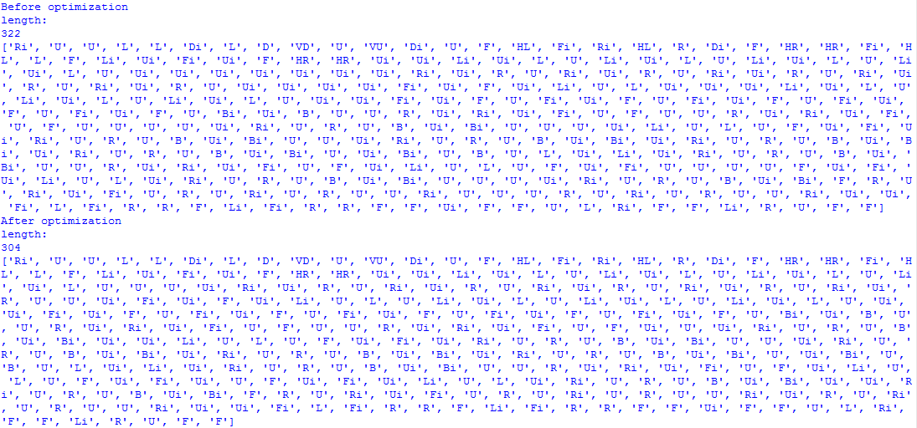

Slide 27
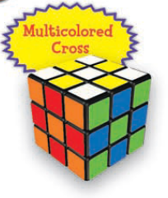
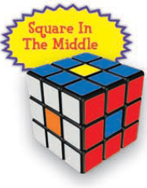
Different Designs

Slide 28
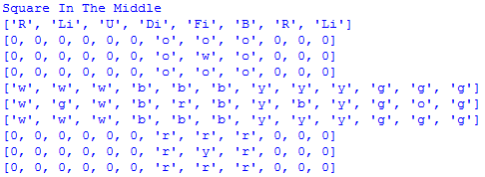
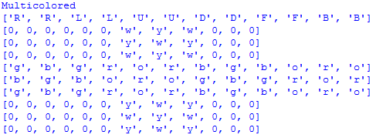
Starts from solved Rubik’s cube
Same steps every time

Slide 29
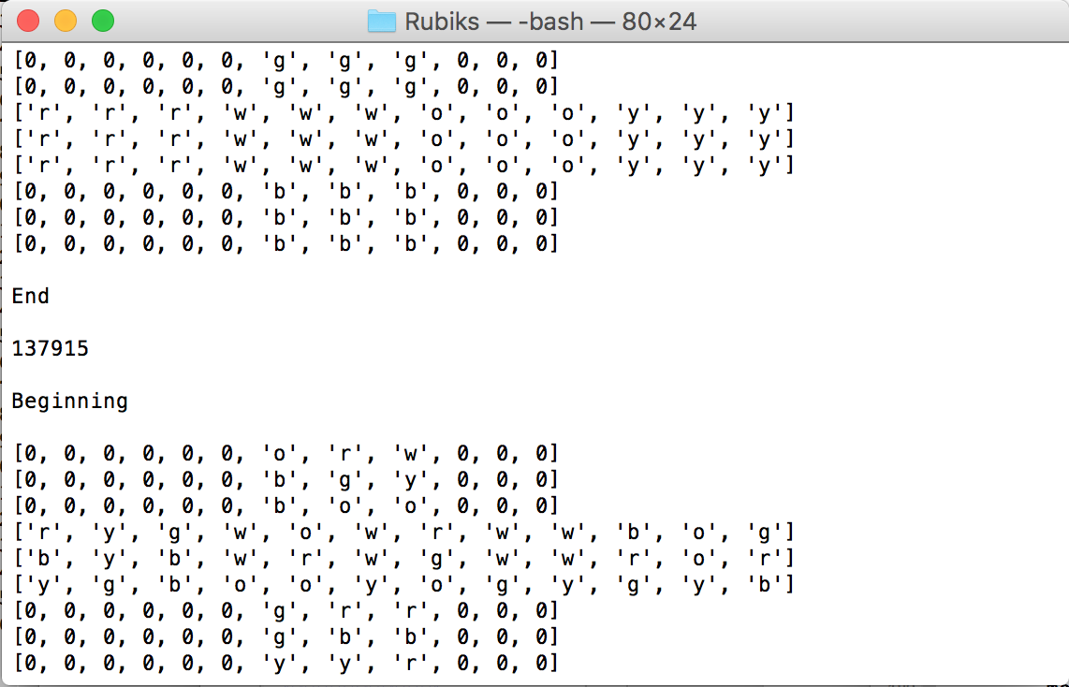
Breaking the Code
Ran over 150,000 test cases
Attempted to break each stage during development and the result is an extremely stable algorithm
No memory leaks
Solving time does not increase as we introduce new test cases

Slide 30
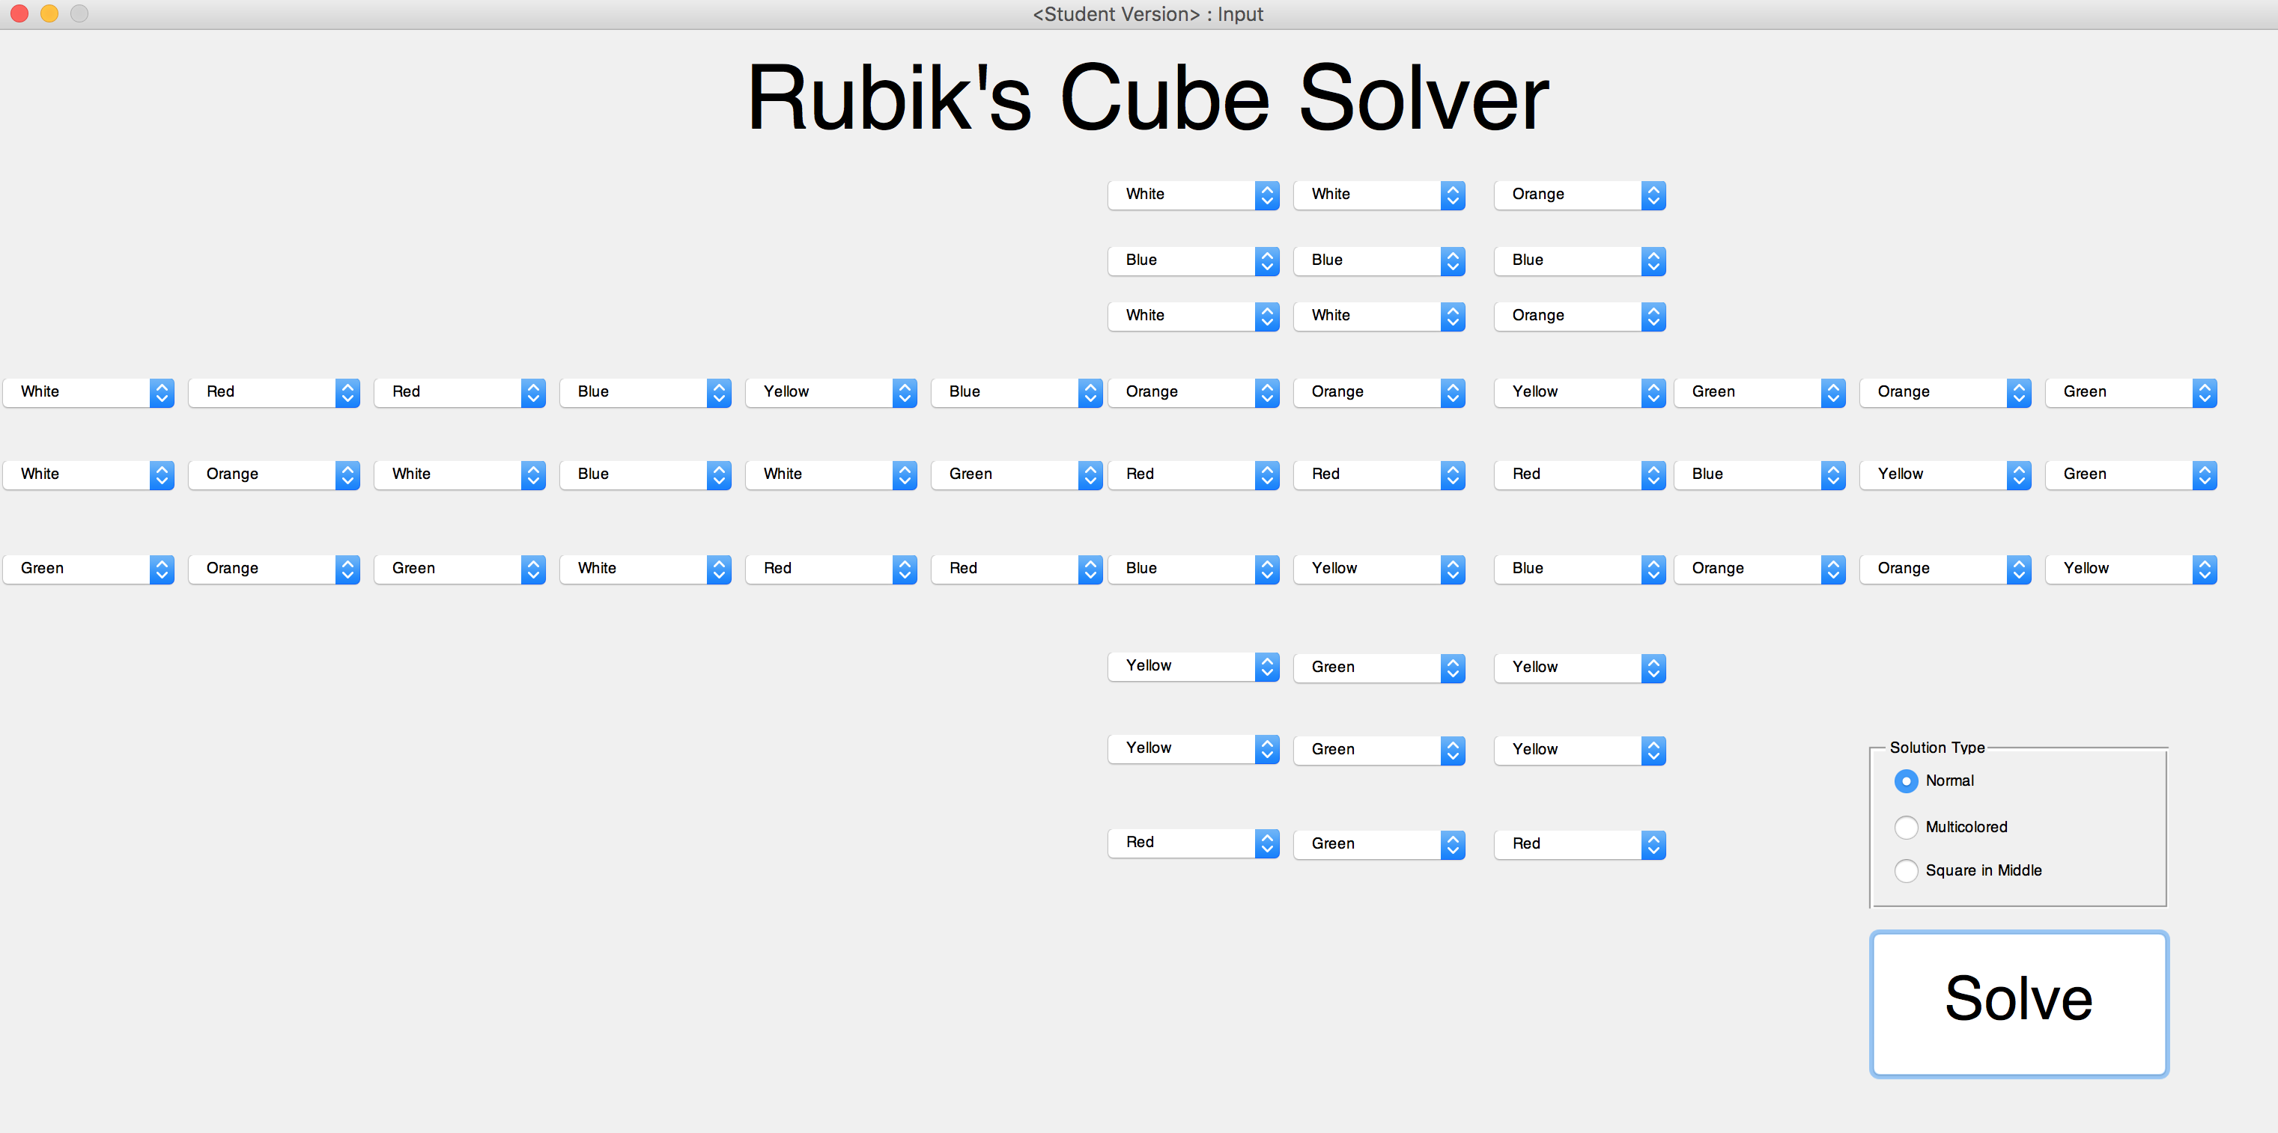
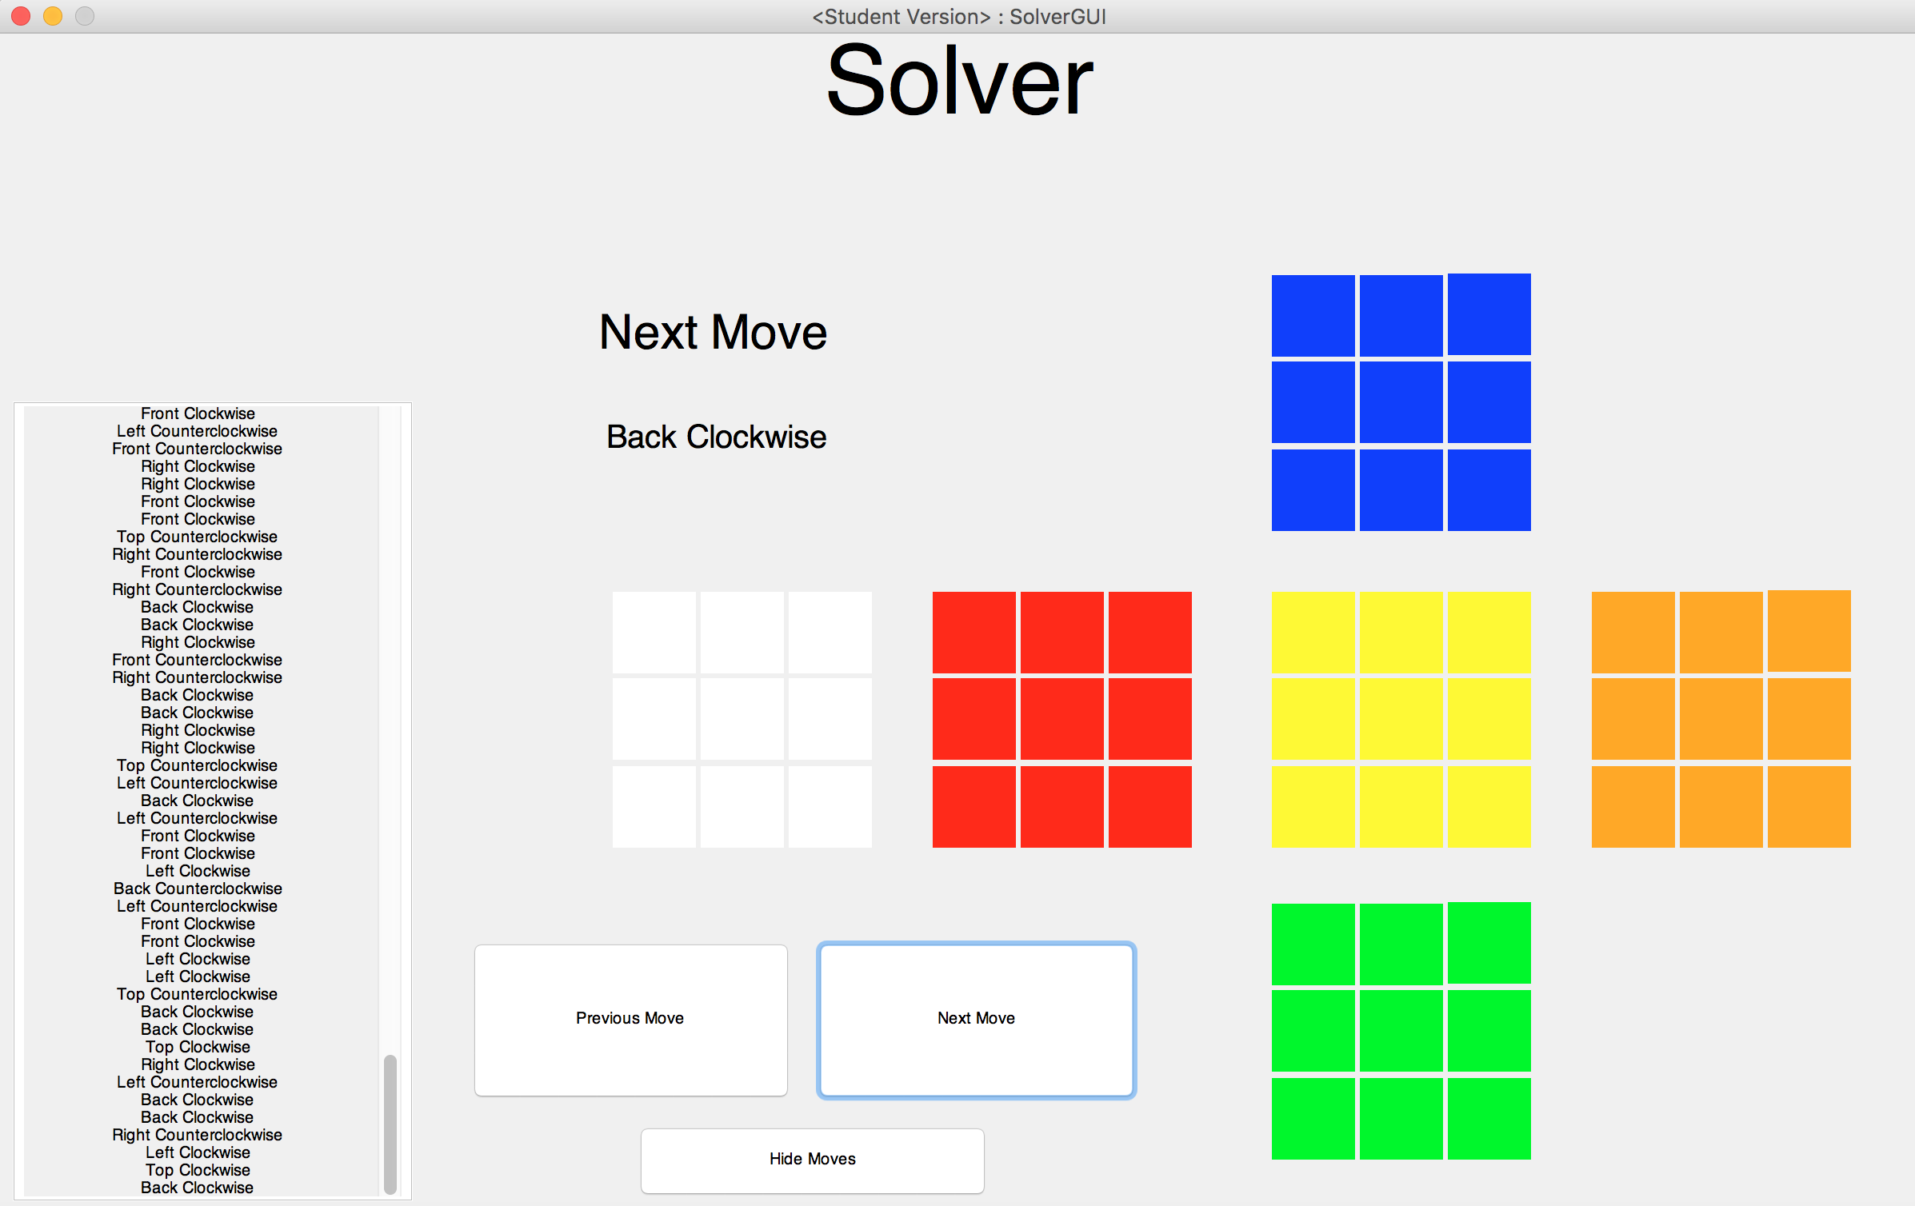
GUI

